Slide 1
E-COMMERCE (ECM-133)
BIT (Third Semester) – Texas College

Slide 2
UNIT III BUSINESS CONCEPTS AND SOCIAL ISSUES
Chapter 6: E-commerce Marketing and Advertising Concepts
Chapter 7: Social, Mobile, and Local Marketing
Chapter 8: Ethical, Social, and Political Issues in E-commerce

Slide 3
UNIT III BUSINESS CONCEPTS AND SOCIAL ISSUES
Chapter 6: E-commerce Marketing and Advertising Concepts

Slide 4
E-COMMERCE MARKETING AND ADVERTISING CONCEPTS
Before firms can begin to sell their products online, they must first understand what kinds of people they will find online and how those people behave in the online marketplace
In this section, we focus primarily on individual consumers in the businessto-consumer (B2C) arena
However, many of the factors discussed apply to the B2B arena as well, insofar as purchasing decisions by firms are made by individuals

Slide 5
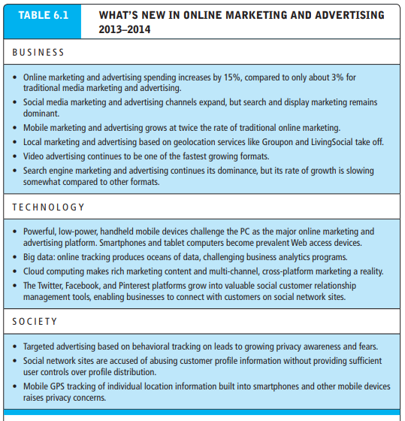
INTERNET TRAFFIC PATTERNS: THE ONLINE CONSUMER PROFILE

Slide 6
TYPE OF INTERNET CONNECTION: BROADBAND AND MOBILE IMPACTS
In 2013, around 85 million households had broadband service in their homes—70% of all households (eMarketer, Inc., 2013e)
Research suggests the broadband audience is different from the dial-up audience: the broadband audience is more educated and affluent
The broadband audience is much more intensely involved with the Internet and much more capable of using the Internet. For marketers, this audience offers unique opportunities for the use of multimedia marketing campaigns, and for the positioning of products especially suited for this audience
On the other hand, the dial-up households still buy products online, visit news sites, and use social network sites—just not as frequently or intensely as broadband households

Slide 7
CONSUMER BEHAVIOR MODELS
Once firms have an understanding of who is online, they need to focus on how consumers behave online. The study of consumer behavior is a social science discipline that attempts to model and understand the behavior of humans in a marketplace
General consumer behavior model that takes into account a wide range of factors that influence a consumer’s marketplace decisions

Slide 8
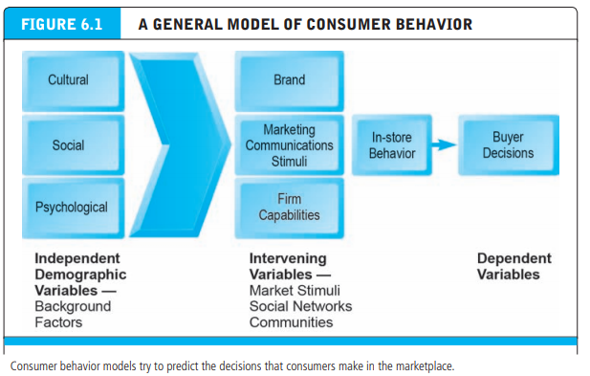
CONSUMER BEHAVIOR MODELS

Slide 9
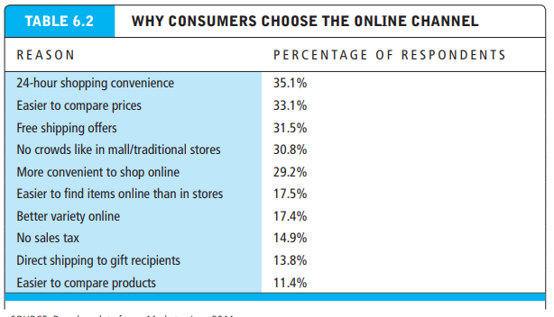
ONLINE PURCHASING DECISION

Slide 10
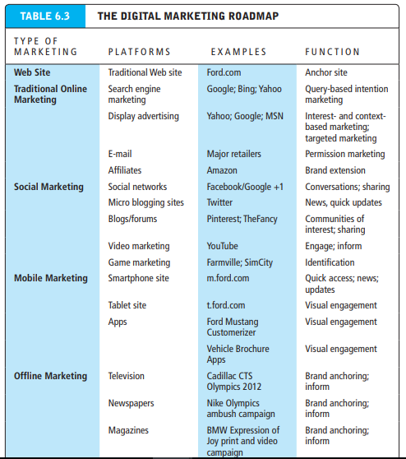
ONLINE MARKETING AND INTERNET ADVERTISING TOOLS

Slide 11
INTERNET MARKETING TECHNOLOGIES
Internet has had four very powerful impacts on marketing
First, the Internet, as a communications medium, has broadened the scope of marketing communications—in the sense of the number of people who can be easily reached as well as the locations where they can be reached, from desktops to mobile smartphones (in short, everywhere)
Second, the Internet has increased the richness of marketing communications by combining text, video, and audio content into rich messages. Arguably, the Web is richer as a medium than even television or video because of the complexity of messages available, the enormous content accessible on a wide range of subjects, and the ability of users to interactively control the experience

Slide 12
INTERNET MARKETING TECHNOLOGIES
Third, the Internet has greatly expanded the information intensity of the marketplace by providing marketers (and customers) with unparalleled fine-grained, detailed, real-time information about consumers as they transact in the marketplace
Fourth, the always-on, always-attached, environment created by mobile devices results in consumers being much more available to receive marketing messages. One result is an extraordinary expansion in marketing opportunities for firms.

Slide 13
INTERNET MARKETING TECHNOLOGIES
Web Transaction Logs
A transaction log records user activity at a Web site. The transaction log is built into Web server software. Transaction log data becomes even more useful when combined with two other visitor-generated data trails: registration forms and the shopping cart database
Databases, Data warehouses, data mining and Big Data
Databases, data warehouses, data mining, and the variety of marketing decision-making techniques loosely called profiling are at the heart of the revolution in Internet marketing. Profiling uses a variety of tools to create a digital image for each consumer

Slide 14
INTERNET MARKETING TECHNOLOGIES
Databases
A database is a software application that stores records and attributes
Data warehouses and data mining
A data warehouse is a database that collects a firm’s transactional and customer data in a single location for offline analysis by marketers and site managers.
The data originate in many core operational areas of the firm, such as Web site transaction logs, shopping carts, point-of-sale terminals (product scanners) in stores, warehouse inventory levels, field sales reports, external scanner data supplied by third parties, and financial payment data
Data mining is a set of analytical techniques that look for patterns in the data of a database or data warehouse, or seek to model the behavior of customers

Slide 15
INTERNET MARKETING TECHNOLOGIES
Big Data
Big data usually refers to data in the petabyte and exabyte range—in other words, billions to trillions of records, all from different sources. Big data are produced in much larger quantities and much more rapidly than traditional data. Even though “tweets” are limited to 140 characters each, Twitter generates more than 8 terabytes of data daily
To handle unstructured and semi-structured data in vast quantities, as well as structured data, organizations are using Hadoop. Hadoop is an open source software framework managed by the Apache Software Foundation that enables distributed parallel processing of huge amounts of data across inexpensive computers. It breaks a big data problem down into subproblems, distributes them among up to thousands of inexpensive computer processing nodes, and then combines the result into a smaller data set that is easier to analyze

Slide 16
INTERNET MARKETING TECHNOLOGIES
Customer Relationship Management (CRM) Systems
CRM is a repository of customer information that records all of the contacts that a customer has with a firm and generates a customer profile available to everyone in the firm with a need to “know the customer”

Slide 17
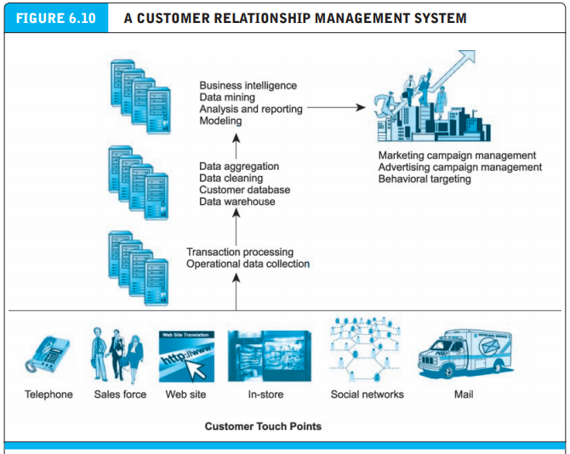
INTERNET MARKETING TECHNOLOGIES

Slide 18
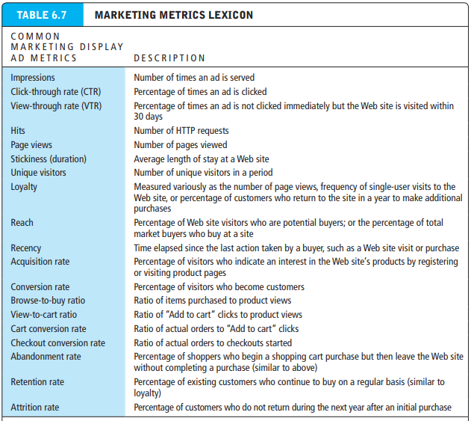
COST AND BENEFITS OF ONLINE MARKETING

Slide 19
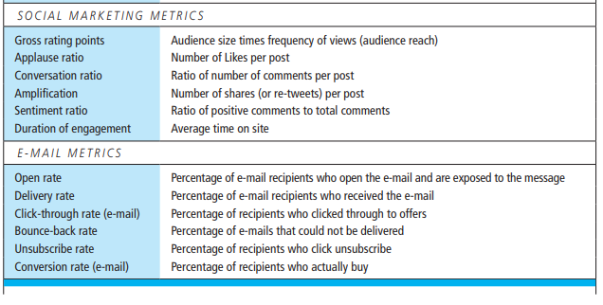
COST AND BENEFITS OF ONLINE MARKETING

Slide 20
UNIT III BUSINESS CONCEPTS AND SOCIAL ISSUES
Chapter 7: Social, Mobile, and Local Marketing

Slide 21
INTRODUCTION TO SOCIAL, MOBILE AND LOCAL MARKETING
Social, mobile, and local marketing have transformed the online marketing landscape. Before 2007, Facebook was a fledgling company limited to college students.
Apple had not yet announced the iPhone.
Online marketing consisted largely of creating a corporate Web site, buying display ads on Yahoo, purchasing Ad Words on Google, and sending e-mail.
The workhorse of online marketing was the display ad that flashed brand messages to millions of users who were not expected to respond immediately, ask questions, or make observations.
The primary measure of success was how many “eyeballs” (unique visitors) a Web site produced, and how many “impressions” a marketing campaign generated. An impression was one ad shown to one person. Both of these measures were carryovers from the world of television, which measures marketing in terms of audience size and ad views.

Slide 22
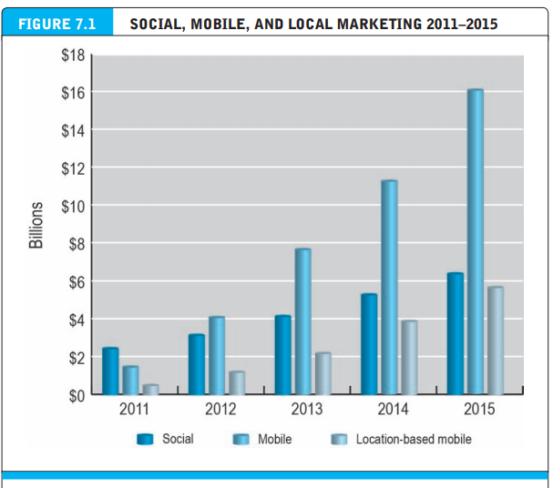
INTRODUCTION TO SOCIAL, MOBILE AND LOCAL MARKETING

Slide 23
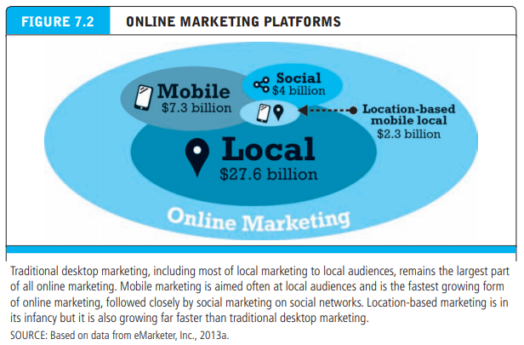
INTRODUCTION TO SOCIAL, MOBILE AND LOCAL MARKETING

Slide 24
SOCIAL, MOBILE AND LOCAL MARKETING
Social, mobile, and local digital marketing are self-reinforcing and connected. For instance, as mobile devices become more powerful, they are more useful for accessing Facebook and other social sites.
As mobile devices become more widely adopted, they can be used by customers to find local merchants, and for merchants to alert customers in their neighborhood to special offers.
Over time, these will become more overlapped as the three platforms become more tightly coupled

Slide 25
SOCIAL MARKETING
Social marketing differs markedly from traditional online marketing. The objectives of traditional online marketing are to put your business’s message in front of as many visitors as possible and hopefully encourage them to come to your Web site to buy products and services, or to find out more information. The more “impressions” (ad views) you get, and the more unique visitors to your site, the better. Traditional online marketing never expected to listen to customers, much less have a conversation with them, any more than TV advertisers expected to hear from viewers.
In social marketing, the objective is to encourage your potential customers to become fans of your company’s products and services, and engage with your business by entering into a conversation with it. Your further objective is to encourage your business’s fans to share their enthusiasm with their friends, and in so doing create a community of fans online

Slide 26
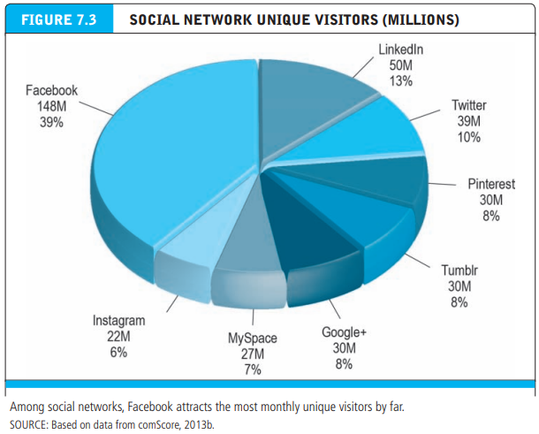
SOCIAL MARKETING PLAYERS

Slide 27
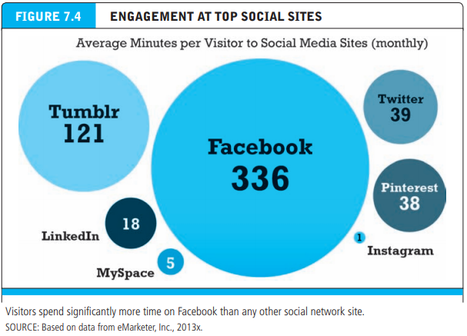
SOCIAL MARKETING PLAYERS

Slide 28
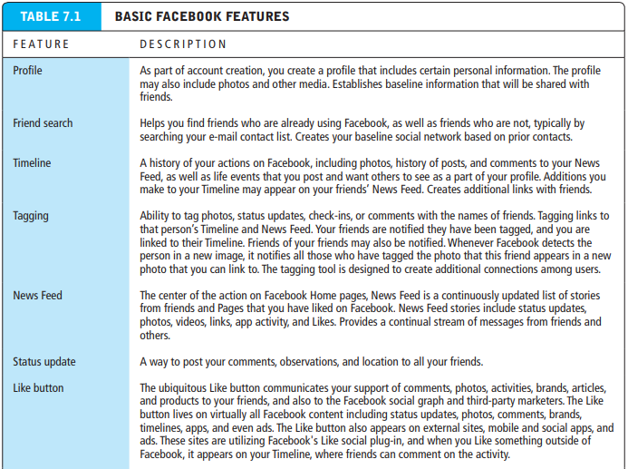
SOCIAL MARKETING PLAYERS – FACEBOOK MARKETING

Slide 29
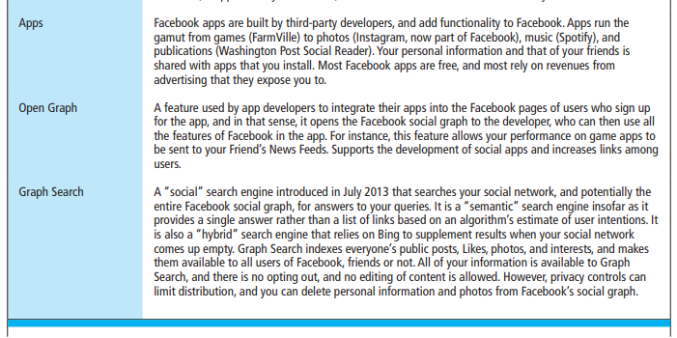
SOCIAL MARKETING PLAYERS – FACEBOOK MARKETING

Slide 30
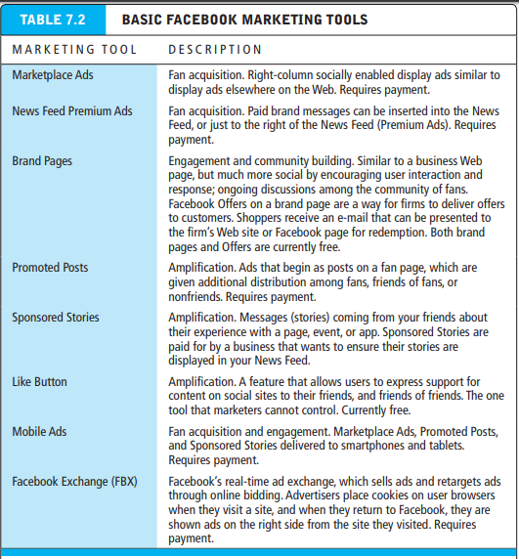
SOCIAL MARKETING PLAYERS – FACEBOOK MARKETING

Slide 31
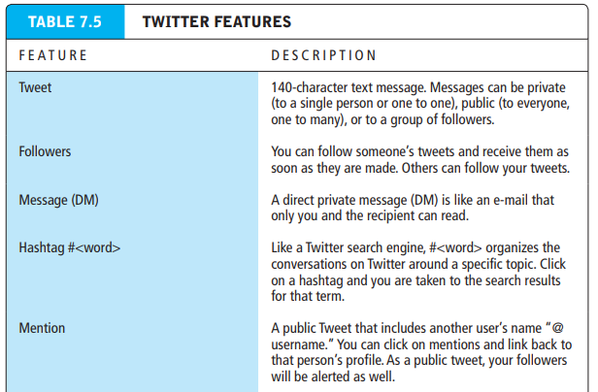
SOCIAL MARKETING PLAYERS – TWITTER MARKETING

Slide 32
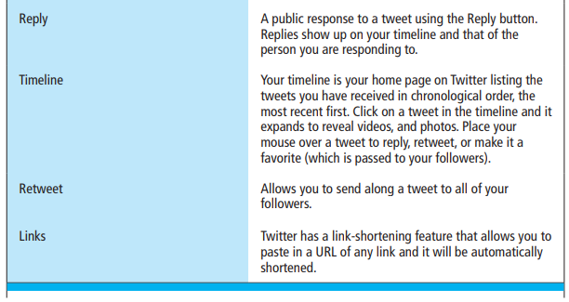
SOCIAL MARKETING PLAYERS – TWITTER MARKETING

Slide 33
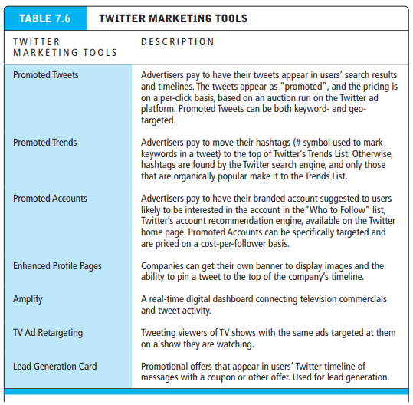
SOCIAL MARKETING PLAYERS – TWITTER MARKETING

Slide 34
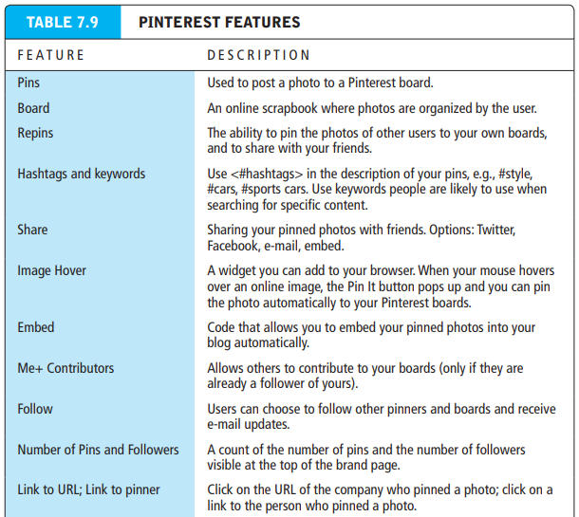
SOCIAL MARKETING PLAYERS – PINTEREST FEATURES

Slide 35
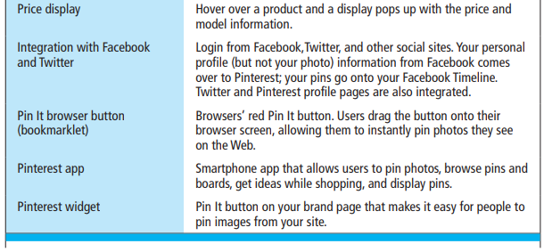
SOCIAL MARKETING PLAYERS – PINTEREST FEATURES

Slide 36
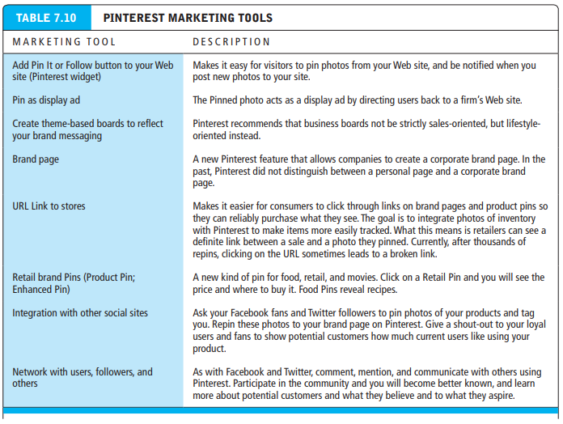
SOCIAL MARKETING PLAYERS – MARKETING TOOLS

Slide 37
MOBILE MARKETING
Overview: M-commerce Today
It’s a short number of steps from owning a smartphone or tablet, to searching for products and services, browsing, and then purchasing. The resulting mobile commerce is growing at over 50% a year, significantly faster than desktop e-commerce at 12% a year. The high rate of growth for mobile commerce will not, of course, continue forever, but analysts estimate that by 2017, mobile commerce will account for 18% of all e-commerce

Slide 38
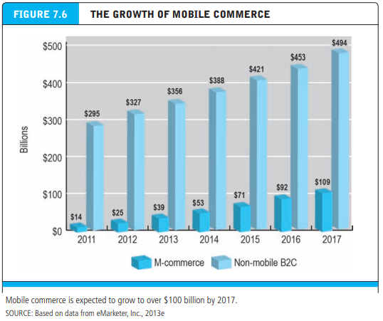
MOBILE MARKETING

Slide 39
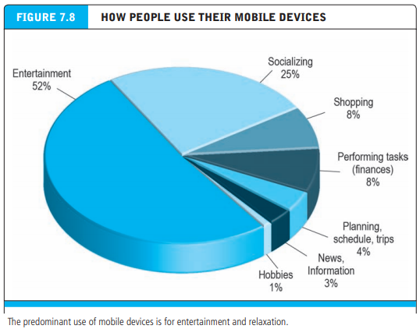
MOBILE MARKETING – USE OF MOBILE DEVICES

Slide 40
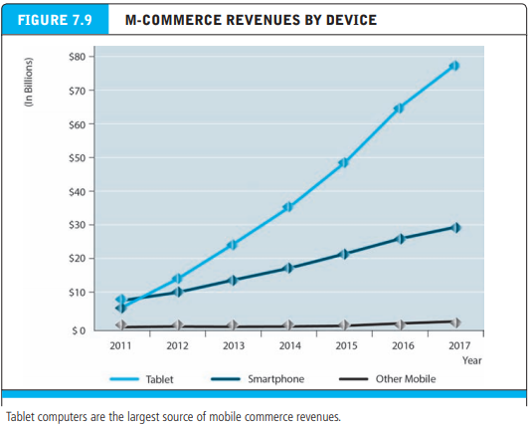
MOBILE MARKETING – REVENUE BY DEVICES

Slide 41
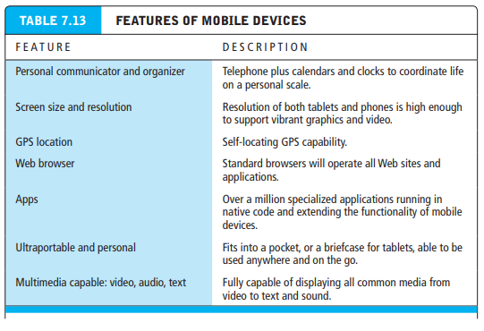
MOBILE MARKETING – FEATURES

Slide 42
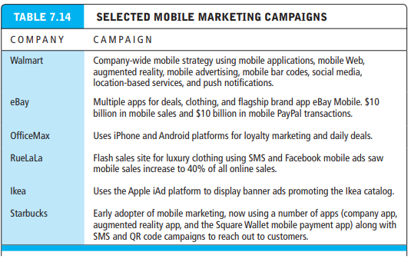
MOBILE MARKETING – CAMPAIGNS

Slide 43
LOCAL AND LOCATION BASED MARKETING
Location-based mobile marketing is the newest and fastest growing segment of the digital marketing universe.
Location-based marketing targets marketing messages to users based on their location. Generally, location-based marketing involves marketing of location-based services. Location-based services involve providing services to users based on their location.
Examples of location-based services are: personal navigation (How do I get there?), point-of-interest (What’s that?), reviews (What’s the best restaurant in the neighborhood?), friend-finder (Where are you? Where’s the crowd?), and family-tracker services (Where is my child?).

Slide 44
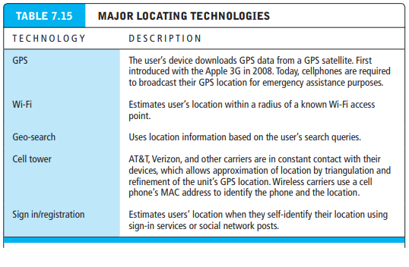
LOCAL AND LOCATION BASED MARKETING - TECHNOLOGIES

Slide 45
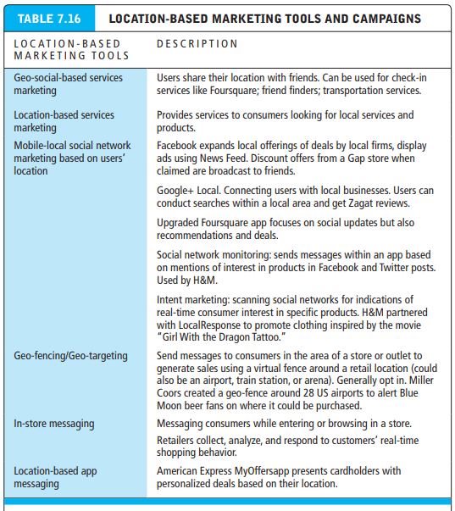
LOCAL AND LOCATION BASED MARKETING – TOOLS AND CAMPAIGNS

Slide 46
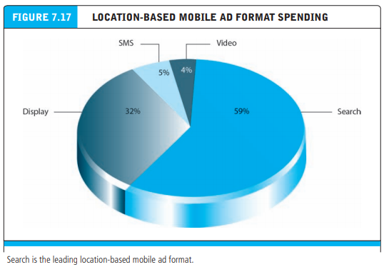
LOCAL AND LOCATION BASED MARKETING – TOOLS AND CAMPAIGNS

Slide 47
UNIT III BUSINESS CONCEPTS AND SOCIAL ISSUES
Chapter 8: Ethical, Social, and Political Issues in E-commerce

Slide 48
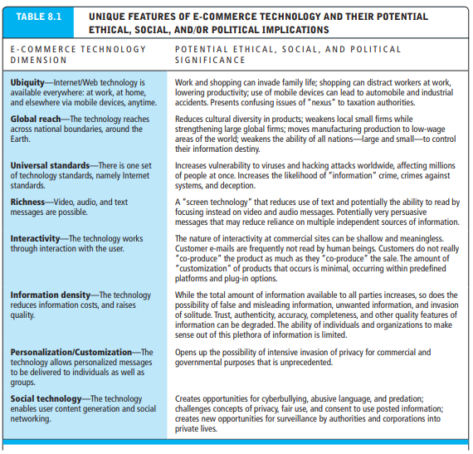
ETHICAL, SOCIAL, AND POLITICAL ISSUES IN E-COMMERCE

Slide 49
A MODEL FOR ORGANIZING THE ISSUES
Issues raised by internet and e-commerce can be viewed at individual, social and political levels which can be described as below
Information rights: What rights to their own personal information do individuals have in a public marketplace, or in their private homes, when Internet technologies make information collection so pervasive and efficient? What rights do individuals have to access information about business firms and other organizations?
Property rights: How can traditional intellectual property rights be enforced in an Internet world where perfect copies of protected works can be made and easily distributed worldwide in seconds?

Slide 50
A MODEL FOR ORGANIZING THE ISSUES
Governance: Should the Internet and e-commerce be subject to public laws? And if so, what law-making bodies have jurisdiction—state, federal, and/or international?
Public safety and welfare: What efforts should be undertaken to ensure equitable access to the Internet and e-commerce channels? Should governments be responsible for ensuring that schools and colleges have access to the Internet? Are certain online content and activities—such as pornography and gambling—a threat to public safety and welfare? Should mobile commerce be allowed from moving vehicles?

Slide 51
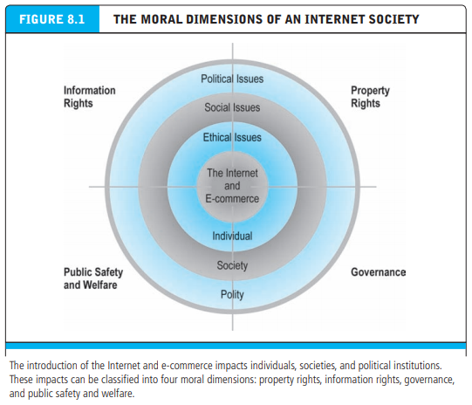
A MODEL FOR ORGANIZING THE ISSUES

Slide 52
BASIC ETHICAL CONCEPTS
Ethics: the study of principles that individuals and organizations can use to determine right and wrong courses of action
Responsibility: as free moral agents, individuals, organizations, and societies are responsible for the actions they take
Accountability: individuals, organizations, and societies should be held accountable to others for the consequences of their actions
Liability a feature of political systems in which a body of law is in place that permits individuals to recover the damages done to them by other actors, systems, or organizations
Due process a process in which laws are known and understood and there is an ability to appeal to higher authorities to ensure that the laws have been correctly applied

Slide 53
ANALYZING ETHICAL DILEMAS
Process for analyzing the ethical dilemas
Identify and clearly describe the facts
Define the conflict or dilemma and identify the higher-order values involved
Identify the stakeholders.
Identify the options that you can reasonably take
Identify the potential consequences of your options

Slide 54
CONCEPT ON PRIVACY AND INFORMATION RIGHTS
Privacy: the moral right of individuals to be left alone, free from surveillance or interference from other individuals or organizations, including the state
Information privacy includes both the claim that certain information should not be collected at all by governments or business firms, and the claim of individuals to control the use of whatever information that is collected about them

Slide 55
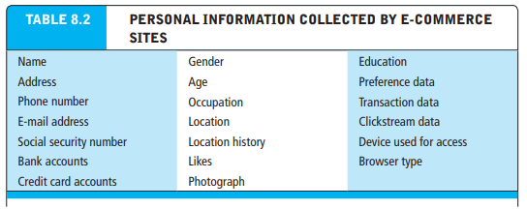
INFORMATION COLLECTED AT E-COMMERCE SITES
Personally identifiable information (PII) any data that can be used to identify, locate, or contact an individual
Anonymous information demographic and behavioral information that does not include any personal identifiers

Slide 56
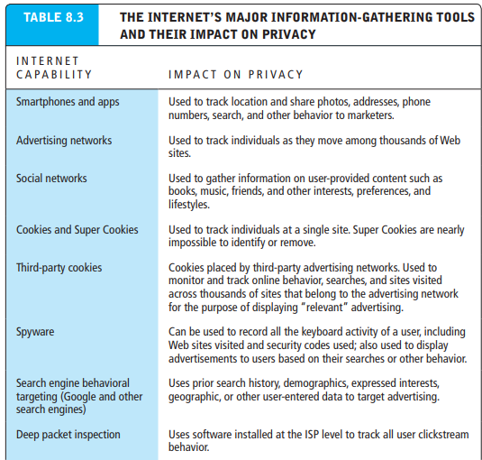
INFORMATION COLLECTED AT E-COMMERCE SITES

Slide 57
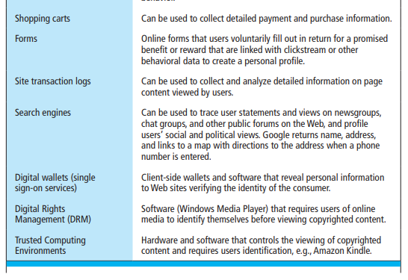
INFORMATION COLLECTED AT E-COMMERCE SITES

Slide 58
PROFILING AND BEHAVIORAL TARGETING
Many Web sites allow third parties—including online advertising networks such as Microsoft Advertising, DoubleClick, and others—to place “third-party” cookies and Web tracking software on a visitor’s computer in order to engage in profiling the user’s behavior across thousands of Web sites. A third-party cookie is used to track users across hundreds or thousands of other Web sites who are members of the advertising network
Profiling the creation of digital images that characterize online individual and group behavior
Anonymous profiles identify people as belonging to highly specific and targeted groups
Personal profiles add a personal e-mail address, postal address, and/or phone number to behavioral data
Deep packet inspection a technology for recording every key stroke at the ISP level

Slide 59
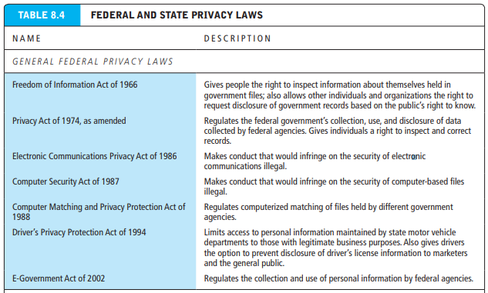
LEGAL PROTECTIONS
Informed consent: consent given with knowledge of all material facts needed to make a rational decision

Slide 60
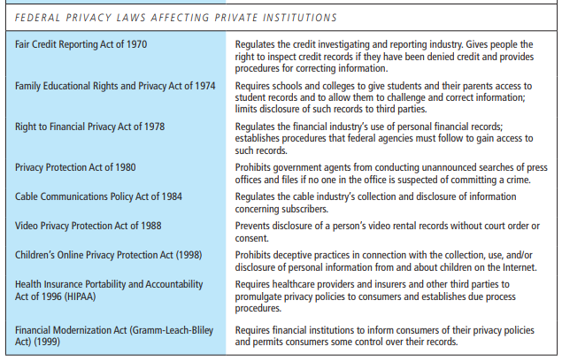
LEGAL PROTECTIONS

Slide 61
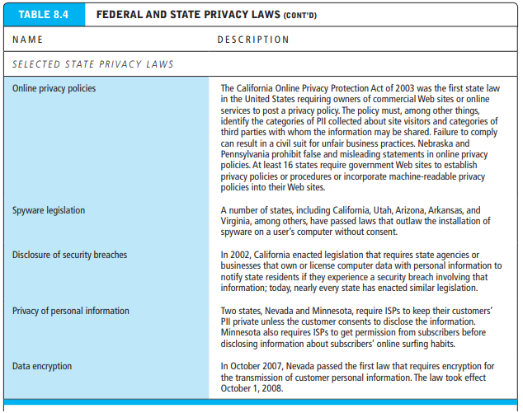
LEGAL PROTECTIONS

Slide 62
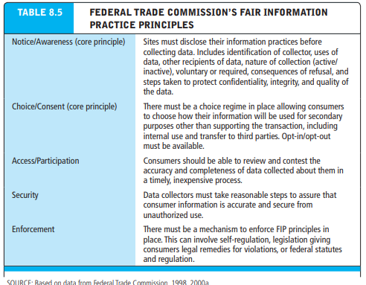
LEGAL PROTECTIONS – FEDERAL TRADE COMMISSIONS (FTC)

Slide 63
LEGAL PROTECTIONS – SAFE HARBOR
Safe harbor framework was developed for U.S. firms while working with European Commission. A safe harbor is a private self-regulating policy and enforcement mechanism that meets the objectives of government regulators and legislation, but does not involve government regulation or enforcement.
The government plays a role in certifying safe harbors, however. Organizations that decide to participate in the safe harbor program must develop policies that meet European standards, and they must publicly sign on to a Web-based register maintained by the Department of Commerce. Enforcement occurs in the United States and relies to a large extent on self-policing and regulation, backed up by government enforcement of fair trade statutes. For more information on the safe harbor procedures and the E.U. Data Directive, see www.export.gov/safeharbor.

Slide 64
INTELLECTUAL PROPERTY RIGHTS
Intellectual Property (IP) is a legal term that has been associated with industrial property with copyrights and other rights in the similar field. It is a process where someone creates anything from their mind like inventions, literary, artistic works, designs, symbols, names and images which are used in E-commerce
The goal of intellectual property law is to balance two competing interests—the public and the private. The public interest is served by the creation and distribution of inventions, works of art, music, literature, and other forms of intellectual expression. The private interest is served by rewarding people for creating these works through the creation of a time-limited monopoly granting exclusive use to the creator

Slide 65
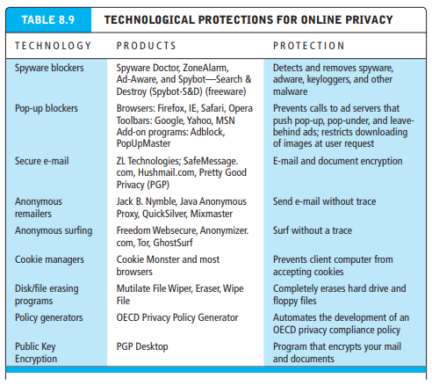
INTELLECTUAL PROPERTY RIGHTS

Slide 66
TYPES OF INTELLECTUAL PROPERTY PROTECTION
Copyright law protects original forms of expression such as writings, art, drawings, photographs, music, motion pictures, performances, and computer programs from being copied by others for a minimum of 70 years
Copyright protection is clear-cut: it protects against copying of entire programs or their parts. Damages and relief are readily obtained for infringement. The drawback to copyright protection is that the underlying ideas behind a work are not protected, only their expression in a work. A competitor can view the source code on your Web site to see how various effects were created and then reuse those techniques to create a different Web site without infringing on your copyright.

Slide 67
TYPES OF INTELLECTUAL PROPERTY PROTECTION
Look and Feel
“Look and feel” copyright infringement lawsuits are precisely about the distinction between an idea and its expression. For instance, in 1988, Apple Computer sued Microsoft Corporation and Hewlett-Packard Inc. for infringing Apple’s copyright on the Macintosh interface. Among other claims, Apple claimed that the defendants copied the expression of overlapping windows. Apple failed to patent the idea of overlapping windows when it invented this method of presenting information on a computer screen in the late 1960s

Slide 68
TYPES OF INTELLECTUAL PROPERTY PROTECTION
Fair Use Doctrine
The doctrine of fair use permits teachers and writers to use copyrighted materials without permission under certain circumstances
The Digital Millennium Copyright Act of 1998
The Digital Millennium Copyright Act (DMCA) of 1998 was the first major effort to adjust the copyright laws to the Internet age

Slide 69
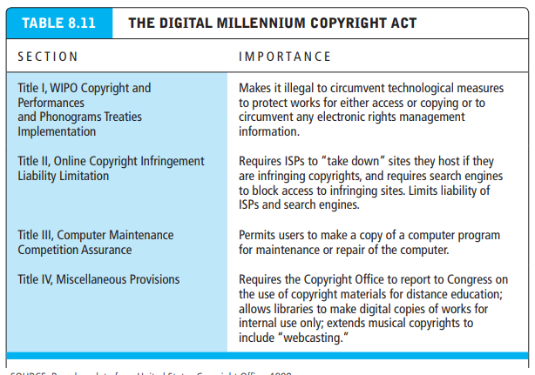
TYPES OF INTELLECTUAL PROPERTY PROTECTION

Slide 70
TYPES OF INTELLECTUAL PROPERTY PROTECTION : PATENT
A patent grants the owner a 20-year exclusive monopoly on the ideas behind an invention. The congressional intent behind patent law was to ensure that inventors of new machines, devices, or industrial methods would receive the full financial and other rewards of their labor and still make widespread use of the invention possible by providing detailed diagrams for those wishing to use the idea under license from the patent’s owner

Slide 71
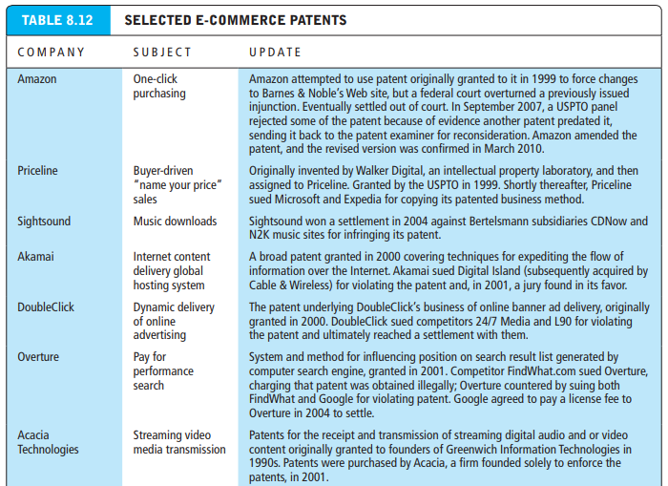
TYPES OF INTELLECTUAL PROPERTY PROTECTION

Slide 72
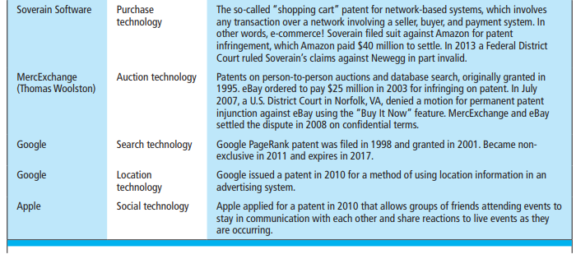
TYPES OF INTELLECTUAL PROPERTY PROTECTION

Slide 73
TYPES OF INTELLECTUAL PROPERTY PROTECTION : TRADEMARK
Trademark law is a form of intellectual property protection for trademarks—a mark used to identify and distinguish goods and indicate their source. The purpose of trademark law is twofold. First, trademark law protects the public in the marketplace by ensuring that it gets what it pays for and wants to receive. Second, trademark law protects the owner—who has spent time, money, and energy bringing the product to the marketplace—against piracy and misappropriation. Trademarks have been extended from single words to pictures, shapes, packaging, and colors

Slide 74
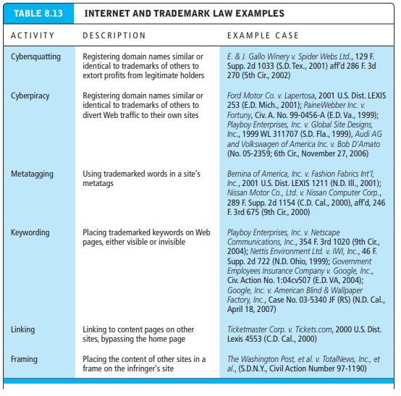
TYPES OF INTELLECTUAL PROPERTY PROTECTION : TRADEMARK

Slide 75
E-COMMERCE : GOVERNANCE
Governance has to do with social control: Who will control the Internet? Who will control the processes of e-commerce, the content, and the activities? What elements will be controlled, and how will the controls be implemented?
A natural question arises and needs to be answered: Why do we as a society need to “control” e-commerce? Because e-commerce and the Internet are so closely intertwined (though not identical), controlling e-commerce also involves regulating the Internet

Slide 76
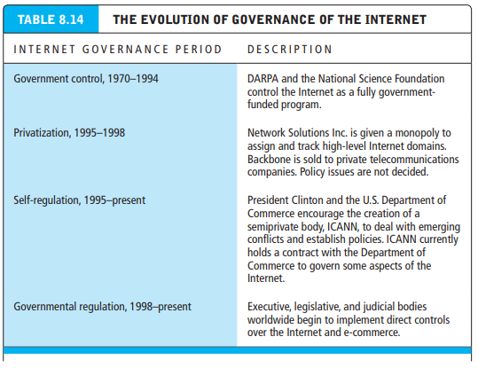
WHO GOVERNS THE INTERNET AND E-COMMERCE?

